Slide 1
Reagan-Udall Foundation for the FDA
How public-private partnerships modernize regulatory science
and advance public health

Slide 2
Role and Mission
Created by Congress in 2007 as an independent 501(c)(3) not-for-profit organization
Established to support and promote regulatory science to advance the FDA’s mission
Serves as a neutral third party to coordinate public-private partnerships with and between FDA and other stakeholders

Slide 3
Reagan-Udall Foundation for the FDA
Does not lobby
Does not influence FDA regulation
Takes no position on legislation

Slide 4
Why a Foundation?
FDA (Mission at Risk) Science Board Report concluded:
Technological advances were accelerating regulatory complexity
FDA resources were not keeping up with demands
Agency needed addt’l support to maintain scientific capability

Slide 5
How it works
Avoids regulatory conflict
Neutral, third-party stakeholder convener
Solicits funding to support mission and programs

Slide 6
New programs include:
IMEDS
Expanded Access Navigator
FDA Fellowships

Slide 7
IMEDS
Framework and entry point for private-sector entities, such as regulated industry, into Sentinel
Analyses of medical product safety evaluations and custom studies
Collaboration with Sentinel data partners and Harvard Pilgrim HealthCare Institute (Analytic Center)

Slide 9
Communication and result dissemination
Report findings released to public after project completion
Results posted to the Foundation’s IMEDS webpage
Abstracts and/or manuscripts are encouraged

Slide 10
Why Expanded Access?
FDA grants speedy approval to more than 99% of requests with company agreement but patients didn’t know the systems works

Slide 11
The need for more information
Single-patient expanded access is critical when the rareness of a disease, or geographical isolation, makes clinical trials challenging.

Slide 12
Enter the Navigator

Slide 13
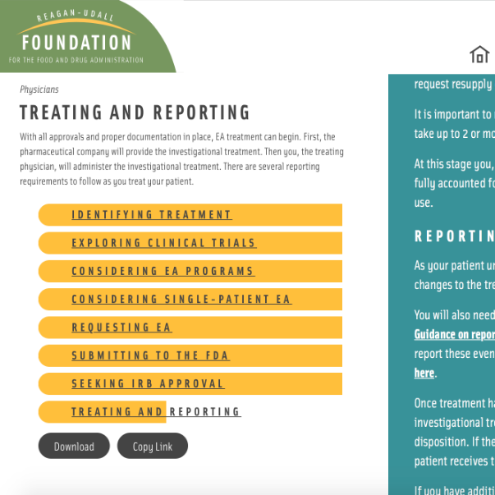
How the Navigator helps
Notes:
I’m okay with the overlap here

Slide 14
What sets the Navigator apart from other resources?
Notes:
I intended this overlap

Slide 15
Intended outcomes
Reduced knowledge gap
More effective, efficient process
Informed physician/patient decision-making
Increased health equity
Easier access to company information
Improved compliance with FDA reporting requirements

Slide 16
Collaboration increases impact
88 media mentions with reach > 36 million
10,000 visits to website after media launch
Partners continuing to reach physicians & advocates through social communications

Slide 17
FELLOWSHIPS
Preparing the next generation of regulatory scientists to meet the complex and specialized technical demands of the future

Slide 18
Who qualifies?
Post-doctoral students
Career scientists
US citizens fully divested from FDA-regulated industry

Slide 19
It’s all about the patients
FDA Commissioner Scott Gottlieb

Slide 20
Reagan-Udall Foundation for the FDA
For questions or more information call (202) 849-2075 or email:
navigator@reaganudall.org
imeds@reaganudall.org
fellowships@reaganudall.org

